Slide 1
Metro VE Extras Installation Guide
Using the Metro_VE_Extras repository to install and use the VisionEval model for Metro
January 2024

Slide 2
Step 1: Clone the VisionEval-Dev and Metro_VE_Extras repositories
Use the RSG Github page to clone both the VisionEval-Dev and Metro_VE_Extras repositories using your Git-compatible software of choice
VisionEval-Dev link for cloning: https://github.com/RSGInc/VisionEval-Dev.git
Metro_VE_Extras link for cloning: https://github.com/RSGInc/Metro-VE-Extras.git
Software options:
  Gitbash: https://gitforwindows.org/
  Github Desktop: https://desktop.github.com/
  Tortoise Git: https://tortoisegit.org/
Preferred R IDE:
  RStudio: https://posit.co/download/rstudio-desktop/

Slide 3
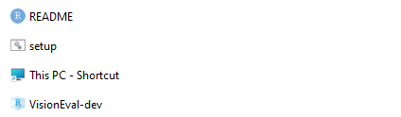
Step 2: Build the VisionEval model
Open the VisionEval-Dev folder on your local machine and open the VisionEval-Dev R project
Build the model by entering “ve.build()”. Depending on the speed of the machine, this will likely take several hours.
Once complete, open the Metro_VE_Extras folder on your local machine. Open the “setup” batch file.
Metro VE Extras
This Repo stores Metro specific VisionEval files such as packages for model runs, model variants (to reflect reference conditions as well as future STS and preferred scenarios, etc.), and any custom models for Metro.
Specifically, the synthetic population for Metro is created using ACS PUMS data in the VESimHouseholds package, customized for Metro in VESimHouseholdsMetro package.
Powertrain and Fuels information are held in the VEPowertrainsAndFuelsAP2022 and VEPowertransAndFuelsSTS.
Teleworking and sensitivity to built land use form are both accounted for in the VETravelDemandWFH package.

Slide 4
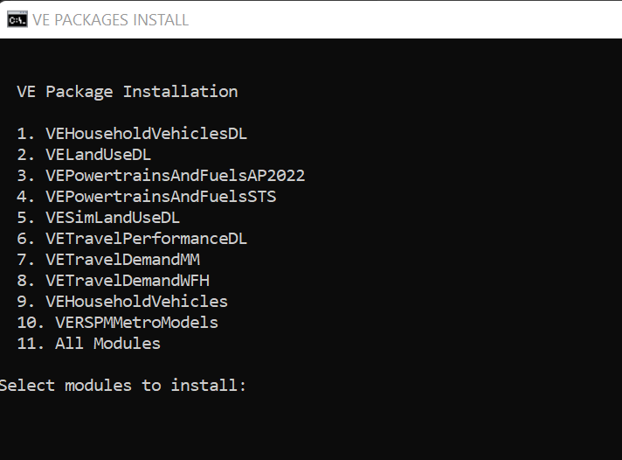
Step 3: Install packages to the VE Library
Enter the following in the command window for the setup file:
The user indicates whether they want to set the R and VE library. Enter “y” and press enter.
  The path to provide for R file should be the R installation directory for the R version you have used to install and build the VisionEval model (ex. “C:\Program Files\R\R-4.2.1”).
  The path to the VE library should be the “ve-lib” folder of the built model (ex. “C:\VisionEval-Dev-metro\built\visioneval\4.2.1\ve-lib”)
A prompt will appear to choose which VE packages to install. You may choose an individual package by entering the corresponding number and pressing enter, or install all by choosing the number for “All Modules.”
Verify the packages have built in the VE Library path.
Note: the Batch file may quit unexpectedly without installing all the packages. This often occurs if a package required a dependency that hasn't been installed. For example, the package "sn" is required.
There is a package by package process that may need to be followed if the batch file process fails to install all the necessary packages. See the next slide step 4.

Slide 5
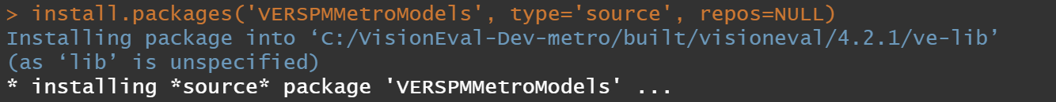
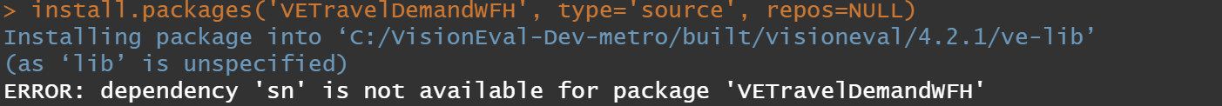
Step 4: Troubleshooting install issues
If the package has not built in the VE Library or displays an error, additional dependency installations may be required.
Open the Metro_VE_Extras folder and open the VisionEval-dev R project.
Use the “install.packages” command to install the desired VE modules (the additional commands “type” and “repos” are required as pictured).
  Install attempts may display a specific error or R packages that need to be installed prior to installing the VE module:
  In this case, the user needs to enter install.packages(“sn”) to install the sn package prior to installing VETravelDemandWFH.
Using this method will install the packages directly into the VE Library of the built runtime.

Slide 6
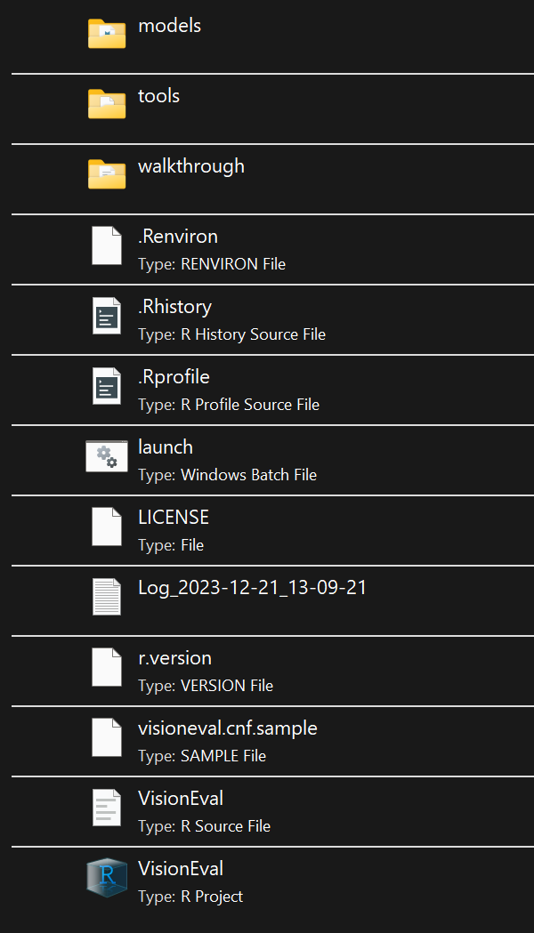
Step 5: Install and run a VE Model
Open the R project VisionEval in “C:\VisionEval-Dev-metro\built\visioneval\4.2.1\runtime”
Open "C:\VisionEval-Dev-metro\built\visioneval\4.2.1\runtime\VisionEval.Rproj"
R Studio should open to the Runtime environment for VisionEval.

Slide 7
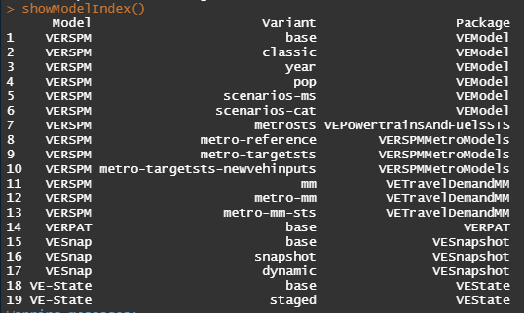
Step 5: Install and run a VE Model
Variants are specific VisionEval models with unique run scripts, input files, and packages that are called during the run_model.R script.
Install VERSPM Metro variant
To view the available VE variants enter showModelIndex(). Models with the “VERSPMMetroModels” package are Metro-specific models to install and run.
Select a variant and install using the following installModel command structure:
  installModel(“VERSPM”, “metro-reference”), and enter “y” when prompted
Metro Variants
Metro-reference: the RTP23+AP22 inputs used to identify the reference scenario with local inputs and adopted statewide trends
Metro-targetSTS: the RTP23+STS inputs used to identify the preferred scenario that achieves the DLCD CFEC Target Rule reductions in VMT and GHG.
Metro-targetsts-newvehinputs: the RTP23+STS inputs adjusting the vehicle age inputs to reflect current conditions and holding those into the future years. The shift of light duty autos vs light duty trucks also reflect current values and hold that into the future.

Slide 8
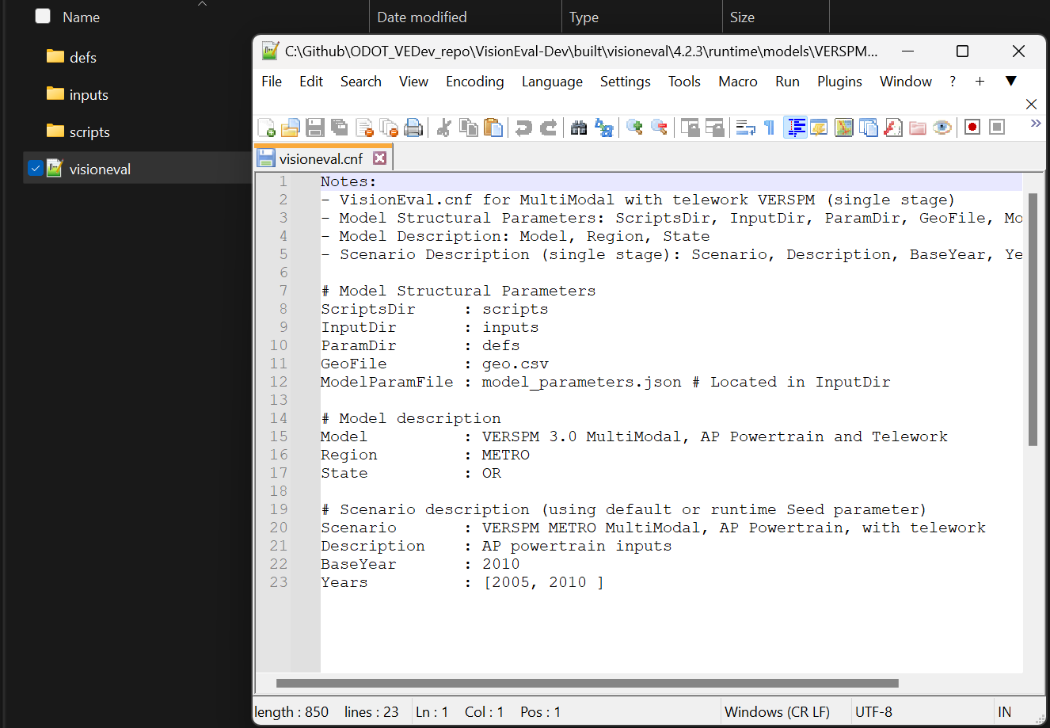
Step 5 (con’t): Install and run a VE Model
Set the Model Configuration
After the model has been installed. Three folders are added to the models/ "name of installed model"
Open up the .cnf file. This file provides background information on the model variant. Most importantly it includes information on the base year of the model and the model years it will include when it runs.
The example shows the two years of 2005 and 2010 being run. Additional years can be run (as long as inputs have been provided). Note – the base year model year needs to be included in the "Years".

Slide 9

Step 5 (con’t): Install and run a VE Model
Open the model and run
To run the model, first store the model as an R object named Model using:
  Model <- openModel(“VERSPM-metro-reference”)
  Then enter Model$run() and ensure the model initializes. VisionEval uses this process to validate that the inputs are all in the anticipated format and there are no missing values across the various geographic levels.

Slide 10
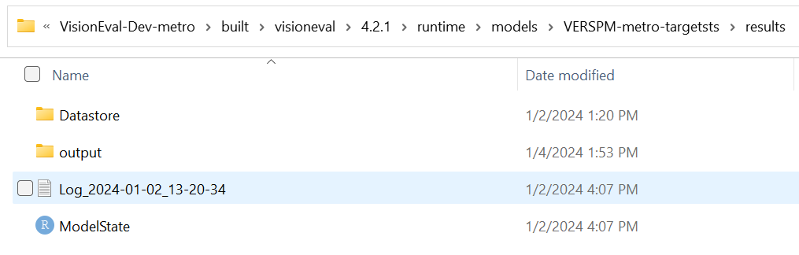
Step 6: Extract Model Results
Extract VE Model Run Results and Filter to the Target Rule Area
Once the model has finished running, use the built in VE export functions to export the model data as CSV outputs using the following code:
  Results <- Model$results() (Note to user. That “Model” here is the name you called your model)
  Results$export()
This will export the results as CSV files to the “results/output” folder. Depending on the number of years in the model, this process could take 15-20 minutes.

Slide 11


Step 6: Extract Model Results (con’t)
Extract VE Model Run Results and Filter to the Target Rule Area
Once the results have exported, open the script “results_compile.R” in Rstudio. This can be found under “scripts” when the model is installed from Metro VE Extras.
  This script compiles model results to a single CSV and filters the data to Bzones identified as in the Target Rule area by Metro. To see the Bzones in the Target Rule area, open “defs/bzone_Summary_Portland.csv”.
  Household data is summed or averaged by Bzone.
    To optionally remove the Bzone filter from household and Bzone-level data, comment out lines 23 & 48 of the script:
Run the full script. Results by geography will be stored under “results/output” in the model directory.

Slide 12
Step 7: Target Rule Calculations
Calculate the Target Rule metrics from the exported results
Once the results have exported, open the script “target_rule_calcs.R” in Rstudio. This can be found under “scripts” when the model is installed from Metro VE Extras.
  This script filters the data to Bzones identified as in the Target Rule area, pulls relevant fields from the exported results, and calculates summaries for the following Target Rule Metrics:
    Population
    Daily CO2e and Daily CO2e per capita
    Annual CO2e and Annual CO2e per capita
    CO2e per DVMT
Run the full script. Results by year will be stored in an Excel file titled “Target Rule Calculations” under “results/output” in the model directory.

